Slide 1
PGDM 2024 – 2026
(PALAS Batch)

Slide 2
Project Overview – Internship at ASAPP Info Global (IMPACCT Division)
Company : ASAPP Info Global Services Pvt. Ltd. – IMPACCT Division (Infrastructure Intelligence Platform)
Area : Infrastructure Analytics | Data Estimation | AI-Driven Insights
Project: Enhancing Infrastructure Intelligence through Data Estimation, Web Scraping & AI Integration
OBJECTIVES
Enhance IMPACCT’s position as the “Bloomberg of Construction”
Enable data-driven decision-making through accurate steel & cement demand forecasting
Reduce latency in data collection and processing across the project lifecycle
Build a premium, AI-integrated platform focusing on high-value clients (e.g., Tata Steel, Autodesk)
Outsource and optimize scraping processes to ensure clean, legal, and efficient data pipelines
Support smarter, safer, and more sustainable infrastructure development

Slide 3






PROJECT BRIEF AND METHODOLOGY
Market & Platform Research
Studied data ecosystems, regulations, and key project platforms.
Automated Data Acquisition
Implemented scalable methods to collect and process infrastructure project data.
Data Structuring & Categorization
Organized raw data into structured formats aligned with business use cases.
Modeling & Analytics Framework
Developed estimation logic and performance indicators for material demand forecasting.
System Integration & AI Readiness
Enabled future integration of AI models and dashboard systems.
Reporting & Strategic Support
Delivered actionable insights and supported product development and decision-making

Slide 4
PROJECT BRIEF AND METHODOLOGY
Demand Forecasting Models: Designed and refined cement & steel estimation multipliers for 60+ infrastructure projects across sectors including residential, commercial, and transport.
Automated Data Extraction: Conducted large-scale data scraping from RERA and Environmental Clearance portals; addressed challenges via outsourcing.
Product Cataloguing & KPI Design: Created structured product catalogues (cement, steel, equipment) and designed 100+ KPIs aligned with infrastructure trends and contractor activity.
AI & LLM Integration: Developed a backend-ready structure to support Large Language Model (LLM) integration for smart query responses and insight generation.
Platform & Report Support: Supported the platform’s internal dashboard development, including reports like Vizag Metro and tender document uploads for client visibility and use-case demonstration.

Slide 5
Results – Community Engagement
Enabled faster and easier client pitching using well-structured, data-backed insights
Built a clean, reliable database increased internal efficiency and external trust
Developed 100+ KPIs tied to material demand and contractor behavior, enhancing dashboard value
Improved platform’s ability to attract better quality clients
Boosted platform’s market visibility via reports, catalogues, and published work
Led to an increase in client inquiries, with several in the active discussion stage
My work in the company’s magazine

Slide 6






Results & Outcomes
Objects Analyzed
3000+
KPIs Designed
100+
AI Integration
with DB
Material Type forecasted
Steel & Cement
Enterprise Clients Approached
Autodesk, Tata Steel
Product Catalogue Built

Slide 7
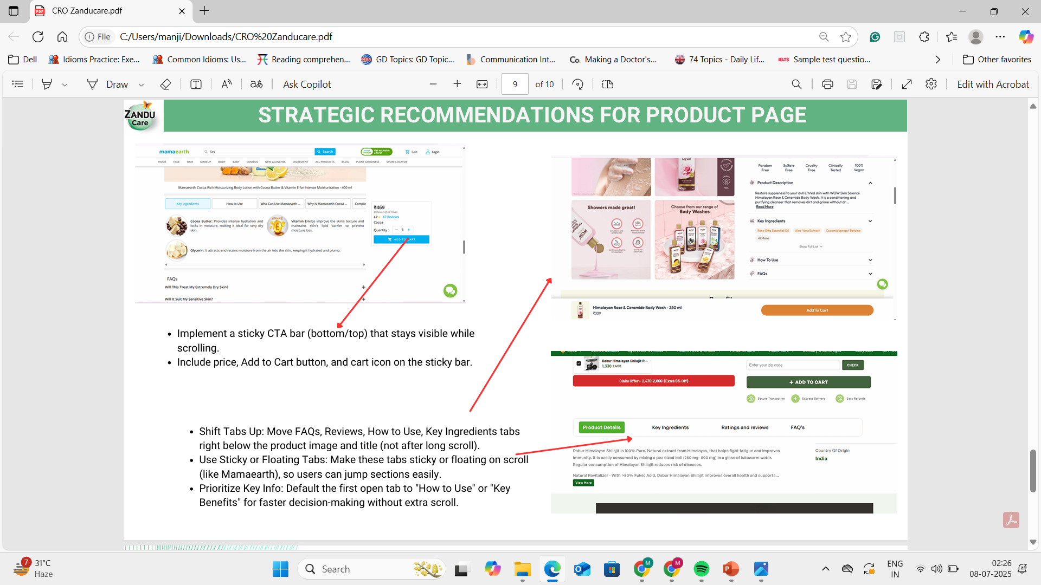
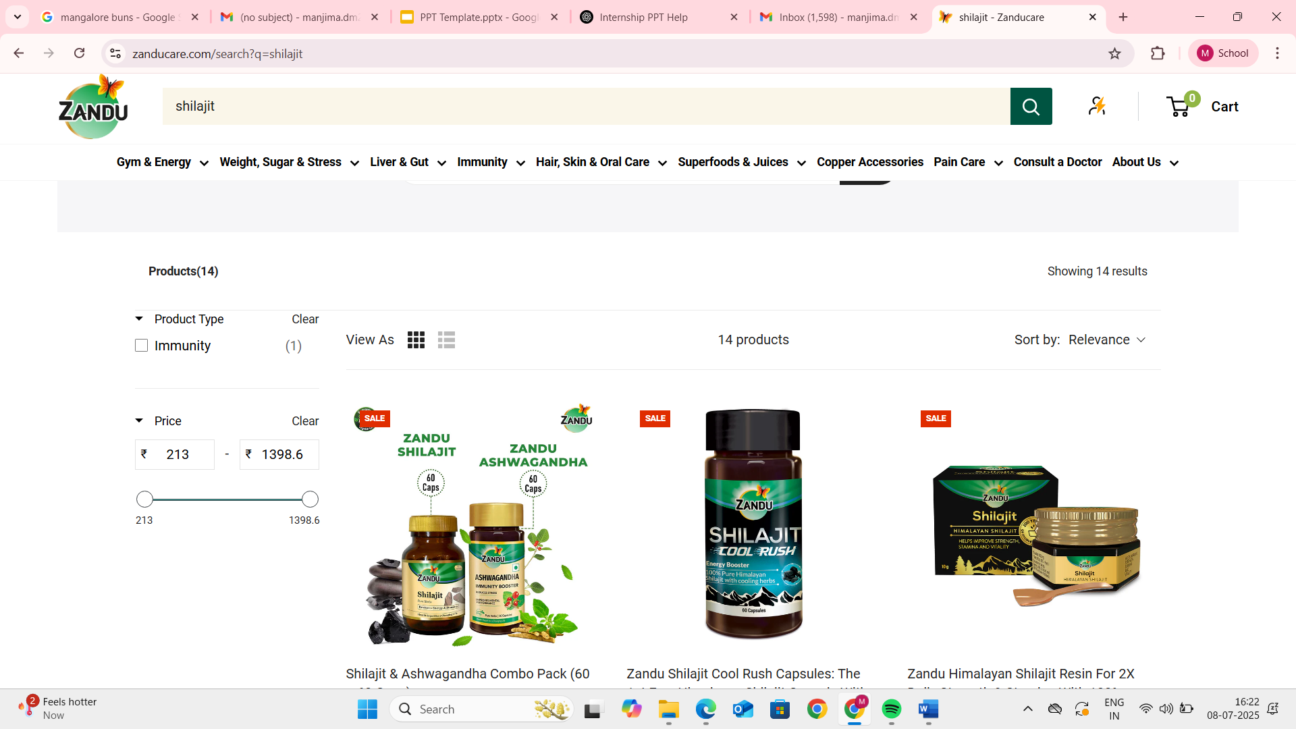
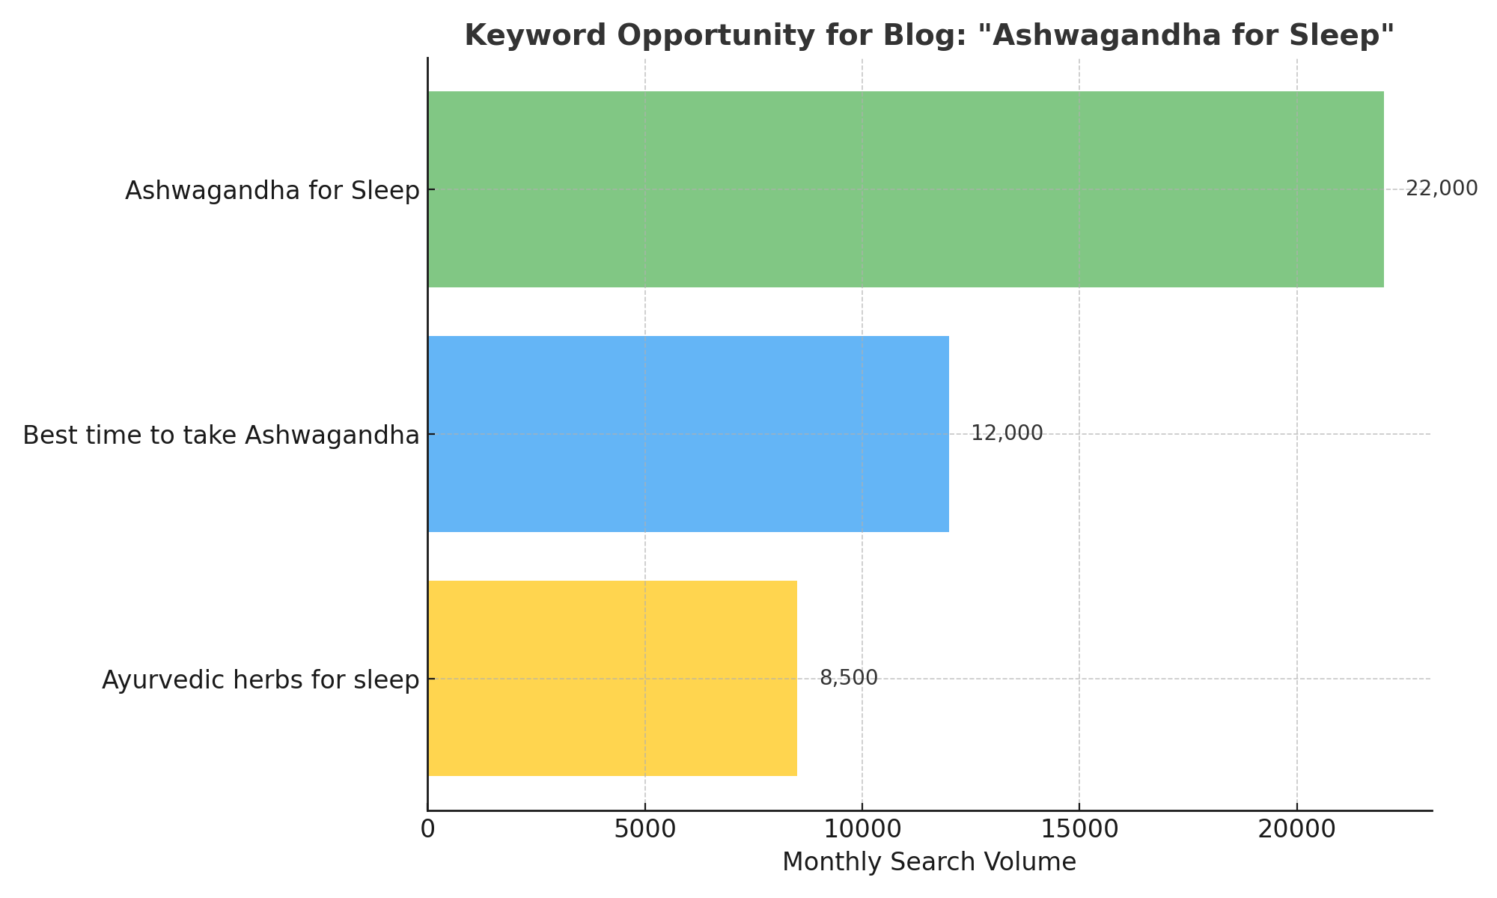
Results – Content Strategy & CRO
Suggested CRO changes: faster load speed, clear CTAs, better mobile UX
Recommended A/B testing & simplified checkout for higher conversions
Outcomes : Enhanced user experience, improved trust, and increased engagement
Created SEO-optimized blog outline targeting 22,000+ monthly searches on “Ashwagandha for Sleep

Slide 8
Impact, Insights & Takeaways
Gained hands-on experience in real estate analytics, data engineering, and AI readiness
Developed an understanding of industry-specific data ecosystems (e.g., RERA, EC portals)
Improved ability to design end-to-end data workflows, from extraction to decision dashboards
🔍 Learnings
⚠️ Challenges
Faced captcha and legal roadblocks during automated data scraping
Mitigated risk by outsourcing scraping to a compliant, specialized third-party vendor

Slide 9
Impact, Insights & Takeaways
🛠️ Unresolved
The transition from contributor to strategic lead is ongoing; deeper involvement in decision-making is the next step
💡 Reflections
Discovered a personal strength and passion for strategic planning, stakeholder alignment, and product thinking
Realized a preference for cross-functional coordination over purely technical development
✨ Value Added to IMPACCT
Delivered a clean, AI-compatible database, structured product catalogues, and 100+ KPI models
Enhanced the platform’s scalability, pitch-readiness, and client acquisition potential

